Slide 1
Employee Data Analysis using Excel
STUDENT NAME: Ruksar Fathima N
REGISTER NO: 422200554
DEPARTMENT: B.com (ISM – Information System Management)
COLLEGE: Guru Shree Shanthi Vijai Jain College For Women

Slide 2
PROJECT TITLE
Employee Performance Analysis using Excel

Slide 3


AGENDA
Problem Statement
Project Overview
End Users
Our Solution and Proposition
Dataset Description
Modelling Approach
Results and Discussion
Conclusion
3/21/2024 Annual Review

Slide 4

PROBLEM STATEMENT
Compare/RATE the SMART Goals and Standards …
~SPECIFIC
~MEASURABLE
~AGREED UPON
~REALISTIC
~TIMEBOUND
…to the actual Employee Performance Results.
1.Document specific occurrences/areas of FAILURE to meet the established standards.
2.Specify a PLAN of improvement.

Slide 5

PROJECT OVERVIEW
SUMIFS: A function that returns the total value of rows in a dataset that meet a defined criteria. This function is useful for obtaining values for reports.
~Performance level = IFS(Z8>=5,”VERY HIGH”,Z8>=4,”HIGH”,Z8>=3,”MED”,TRUE,”LOW”)

Slide 6

WHO ARE THE END USERS?
When using Excel for employee performance analysis, the primary end users are typically managers and HR professionals who need to access and interpret employee performance data to make informed decisions about employee development, compensation, promotions, and overall workforce strategy; employees themselves may also access parts of the analysis to review their own performance and identify areas for improvement.

Slide 7

OUR SOLUTION AND ITS VALUE PROPOSITION
~Conditional formatting -Missing tab
~Filter – Remove
~Fromula – Performance
~Pivot – Summary
~Graph – Data Visualization

Slide 8
Dataset Description
~Employee – Kaggle
~26 Features
~9 Features
~Employee ID – In number
~Employee Type
~Performance level
~Gender – Male / Female
~Employee rating – In number

Slide 9

THE "WOW" IN OUR SOLUTION
Time Champ — Keystrokes, screenshots, screen recordings, audio tracking, and location tracking. Streamline workforce oversight with comprehensive tracking tool | Time Champ. Screen Monitoring. Enhance productivity.Free Trial.
Types: Employee Monitoring, Productivity Tracker.
3/21/2024 Annual Review
9

Slide 10
MODELLING
Key points about end users in employee performance analysis with Excel:
~Direct managers:
They use the analysis to evaluate individual employee performance against set goals, provide feedback, and make decisions regarding performance reviews and salary adjustments.
~HR team:
They aggregate data from across the organization to identify trends, analyze performance patterns, and develop strategic initiatives for talent management.
~Senior leadership:
They may use high-level performance summaries to assess the overall health of the workforce and make informed business decisions.
~Employees themselves:
May access their own performance data to self-reflect on their strengths and weaknesses and identify areas for development.
10

Slide 11
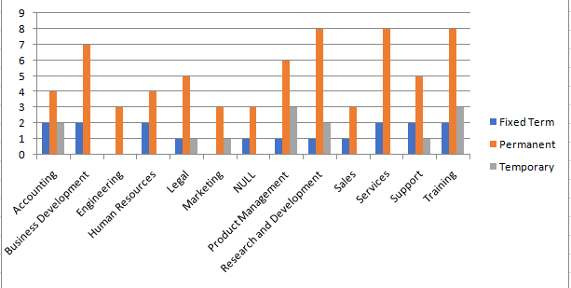
RESULTS
EMPLOYEE PERFORMANCE ANALAYSIS
11

Slide 12
conclusion
Begin by succinctly summarizing the key findings derived from your data analysis. This should include both statistically significant and non-significant results.
-Use clear and concise language, avoiding technical jargon that might be unclear to readers outside your field.
- Gain a new experience form this project.

